Slide 1



UNIVERSITY INSTITUTE OF ENGINEERING
COMPUTER SCIENCE ENGINEERING
Bachelor of Engineering
Design and Analysis of Algorithms(CST-311/ITT-311)
Topic: String matching algorithms
DISCOVER . LEARN . EMPOWER

Slide 2
Learning Objectives & Outcomes
Objective:
To understand the concept of String manipulation / matching algorithms.
Outcome:
Student will understand
Concept of String manipulation/matching algorithms: Rabin Karp, KMP, Boyer Moore algorithm.

Slide 3
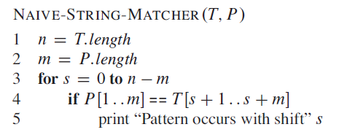
String manipulation/matching algorithms
Naïve brute-force algorithm:

Slide 4
The Rabin-Karp-Algorithm
The Rabin-Karp string matching algorithm calculates a hash value for the pattern, as well as for each M-character subsequences of text to be compared. If the hash values are unequal, the algorithm will determine the hash value for next M-character sequence.
If the hash values are equal, the algorithm will analyze the pattern and the M-character sequence. In this way, there is only one comparison per text subsequence, and character matching is only required when the hash values match.

Slide 5
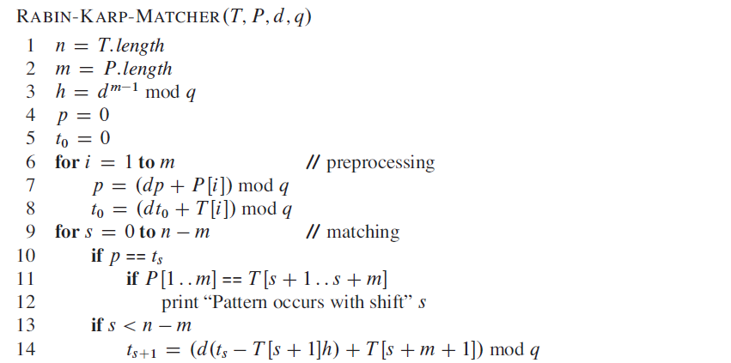
The Rabin-Karp-Algorithm (Contd.)

Slide 6
Complexity
The running time of RABIN-KARP-MATCHER in the worst-case scenario O ((n-m+1) m but it has a good average case running time. If the expected number of strong shifts is small O (1) and prime q is chosen to be quite large, then the Rabin-Karp algorithm can be expected to run in time O (n+m) plus the time to require to process spurious hits.

Slide 7
KMP (Knuth-Morris-Pratt) algorithm
Knuth Morris Pratt (KMP) is an algorithm, which checks the characters from left to right. When a pattern has a sub-pattern appears more than one in the sub-pattern, it uses that property to improve the time complexity, also for in the worst case.
The time complexity of KMP is O(n).
Knuth-Morris and Pratt introduce a linear time algorithm for the string matching problem. A matching time of O (n) is achieved by avoiding comparison with an element of 'S' that have previously been involved in comparison with some element of the pattern 'p' to be matched. i.e., backtracking on the string 'S' never occurs

Slide 8
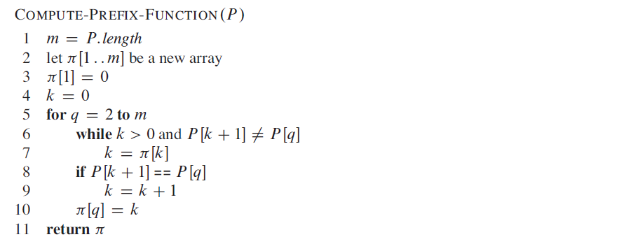
KMP (Knuth-Morris-Pratt) algorithm (contd.)
The Prefix Function(Π)

Slide 9
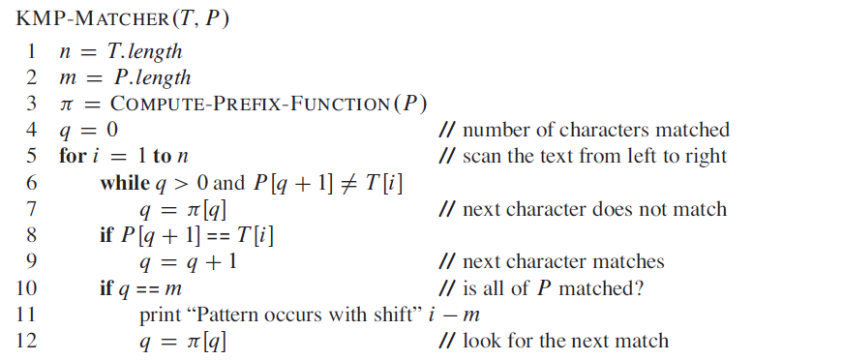
KMP (Knuth-Morris-Pratt) algorithm (contd.)
The KMP Matcher

Slide 10
The Boyer-Moore Algorithm
The two strategies are called heuristics of B - M as they are used to reduce the search. They are:
Bad Character Heuristics
Good Suffix Heuristics

Slide 11
Bad Character Heuristics
This Heuristics has two implications:
Suppose there is a character in a text in which does not occur in a pattern at all. When a mismatch happens at this character (called as bad character), the whole pattern can be changed, begin matching form substring next to this 'bad character.'
On the other hand, it might be that a bad character is present in the pattern, in this case, align the nature of the pattern with a bad character in the text.
Thus in any case shift may be higher than one.

Slide 12
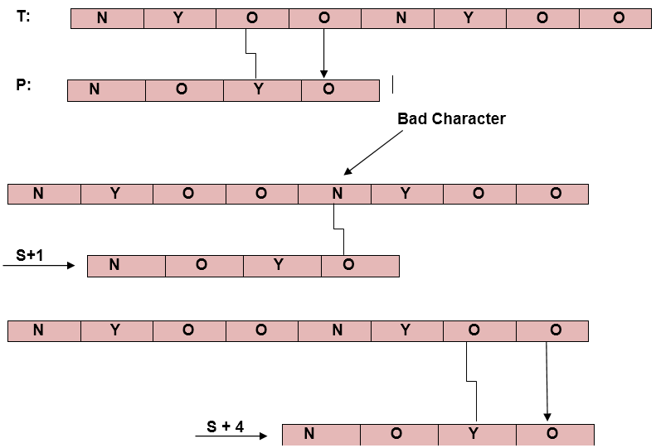
Bad Character Heuristics (Contd.)
Example1: Let Text T = <nyoo nyoo> and pattern P = <noyo>

Slide 13
Good Suffix Heuristics:
A good suffix is a suffix that has matched successfully. After a mismatch which has a negative shift in bad character heuristics, look if a substring of pattern matched till bad character has a good suffix in it, if it is so then we have an onward jump equal to the length of suffix found.

Slide 14
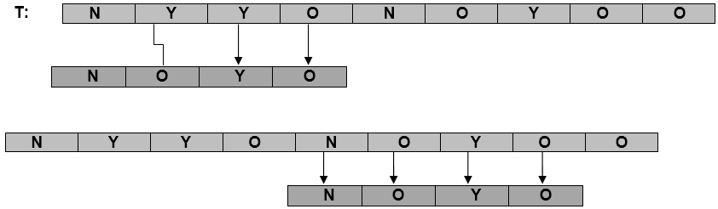
Good Suffix Heuristics (Contd.)
Example

Slide 15
REFERENCES
Text books:
Cormen, Leiserson, Rivest, Stein, “Introduction to Algorithms”, Prentice Hall of India, 3rd edition 2012. problem, Graph coloring.
Websites:
https://www.javatpoint.com/daa-rabin-karp-algorithm#:~:text=The%20Rabin%2DKarp%2DAlgorithm,for%20next%20M%2Dcharacter%20sequence
https://www.javatpoint.com/daa-knuth-morris-pratt-algorithm
https://www.tutorialspoint.com/Knuth-Morris-Pratt-Algorithm
https://www.javatpoint.com/daa-boyer-moore-algorithm

Slide 16
Summary
Concept of String manipulation/matching algorithms:
  Rabin Karp
  KMP,
  Boyer Moore algorithm.

Slide 17
THANK YOU

